Slide 1
Multi-modal Multi-network Key Driver Analysis (MM-KDA)
Ryan Neff
BMSE Software Architecture Update #2
12/7/2017

Slide 2
Context
MM-KDA enables the fusion of multiple gene-gene interaction network datasets into a unified graph that provides an estimate of a gene’s importance in a disease process
Input Networks
Unified Graph

Slide 3
Context
Should be able to identify key drivers on an individual level and cohort level by comparing them to the unified graph
Disease Network
Unified Graph

Slide 4
Current Timeline
Investigate subtype definition from single network data
Thesis proposal drafting
break
Build out MMKDA
Refine key driver analysis identification
Fix Differential Gene Correlation Code to Support Whole GGI networks
Dec 7 Dec 15th Jan 2nd

Slide 5
Progress REPORT
Created a merged MEGENA network that represents the similarities and differences between cluster signatures
16387 nodes, 570k edges!!
5016 edges in >= 4 clusters
Building a multi-network comparison tool from the combined network
Have list of MEGENA hubs for each cluster to do whole-network comparison analysis
Building DB access tool for lab use using rPython (work in progress)
Looked at phenotypic-cluster correlation for top AD biomarker genes
Performed DGCA on top 100,000 gene pairs (=all significant gene pairs) for every cluster
This is genome-wide now and runs in a few hours on our Minerva node vs many days
Defined WGCNA modules for each cluster as well as for the entire ROSMAP set

Slide 6
Requirements
Brief Description | Functional or non-functional | Priority | Status
Identify subtypes of AD | Functional: Group samples into AD subtypes using a statistical model Non-functional: Should be reproducible across different data sets Should be clear and validatable | High | Statistics – done Reproducibility – completed
Find key drivers of unified gene networks | Functional: Apply a statistical model to the network to find key drivers Non-functional: Should be able to use existing and new tools | Med. | Research stage – investigating 3D WGCNA technique
Build a database for the lab to analyze gene networks | Functional: Store gene networks in a database R client is a must Perform statistics on the data Non-functional: Does not need to be accessible by web | Low | Model created and unified graph loaded Statistics can be performed

Slide 7
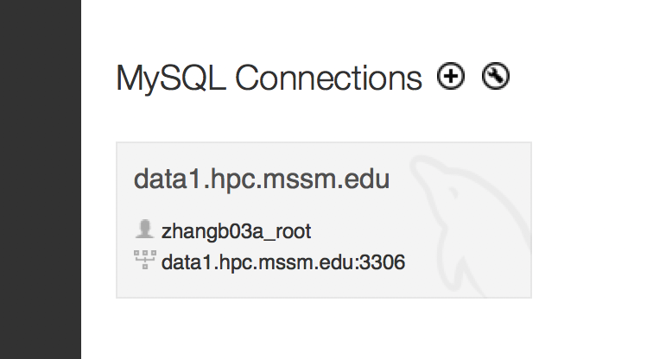
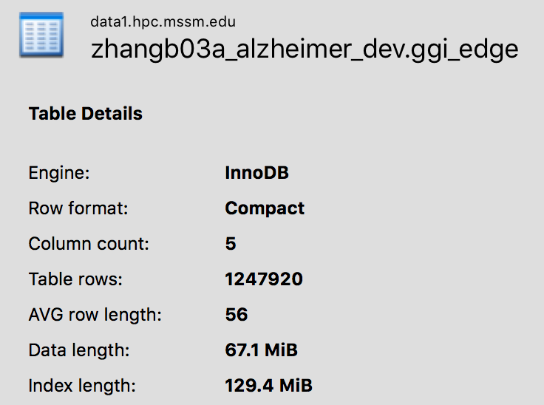
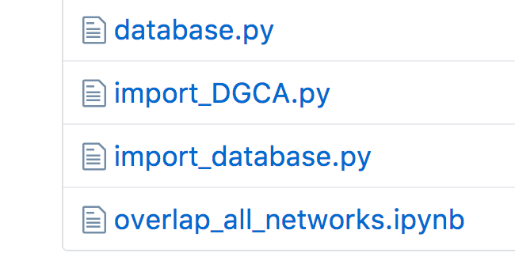
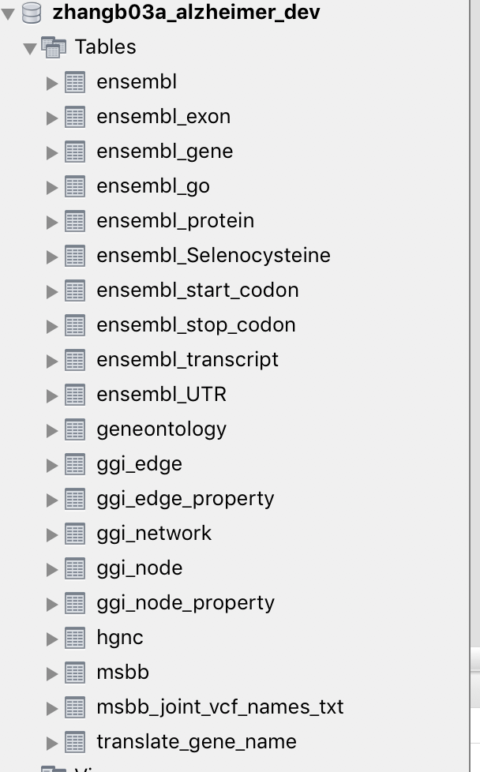
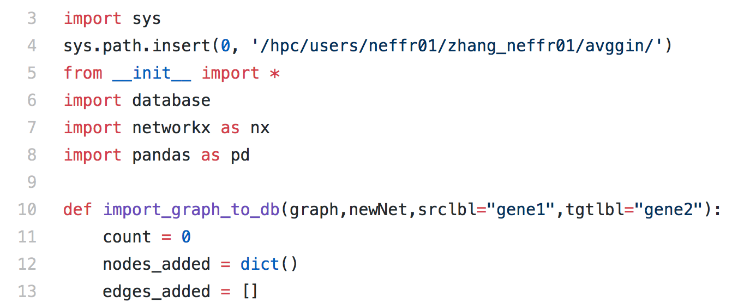
Database Construction

Slide 8
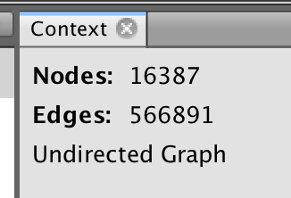
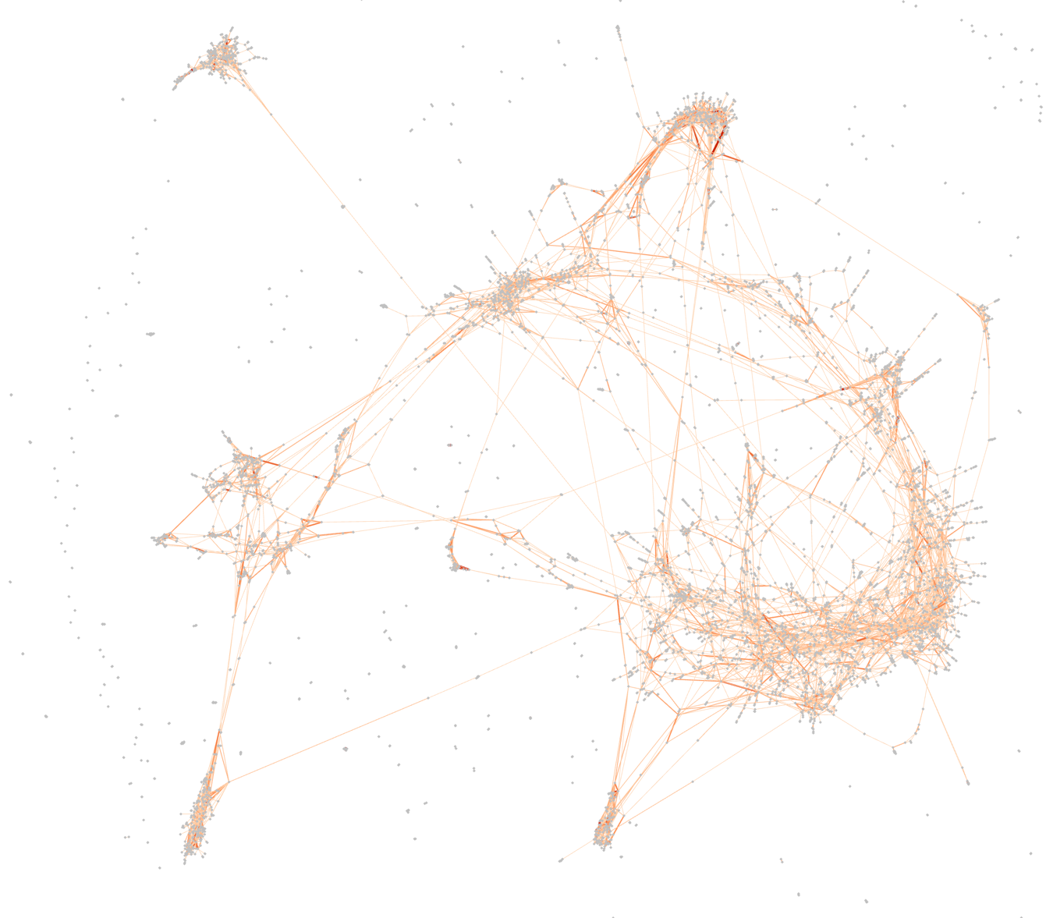
Combined MEGENA graph for multiple clusters
16k nodes, 570k edges total!!
*In image: edges in >3 clusters

Slide 9
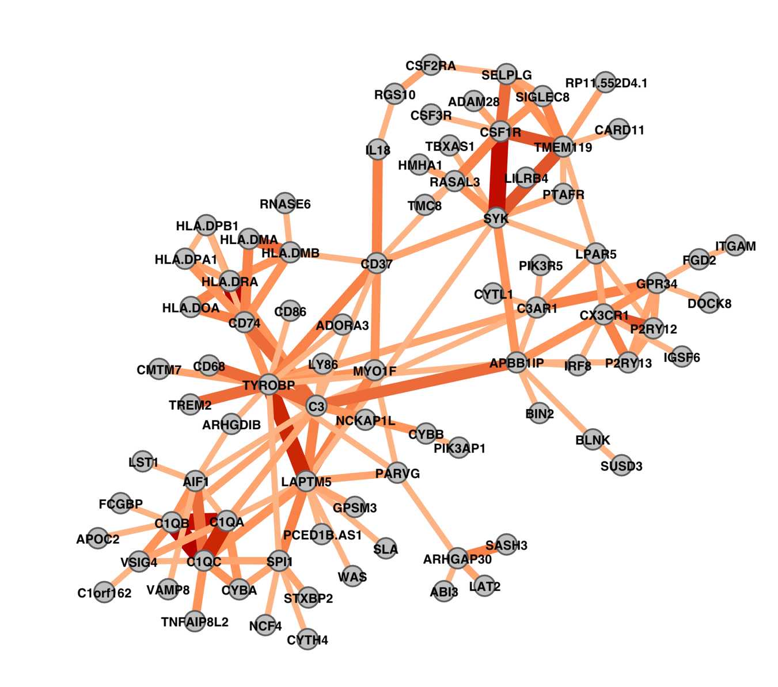
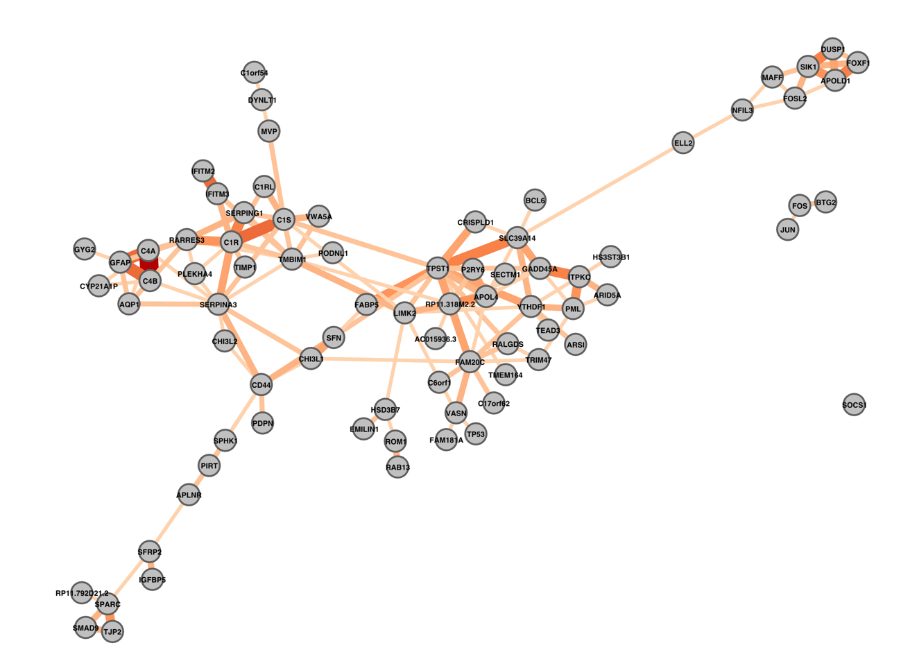
Merged Cluster-Specific MEGENA Networks
TYROBP Subnetwork, edges in >5 clusters
SERPINA3 Subnetwork, edges in >3 clusters
Edge weight: red color + edge size; edge weight = # of clusters that share edge

Slide 10
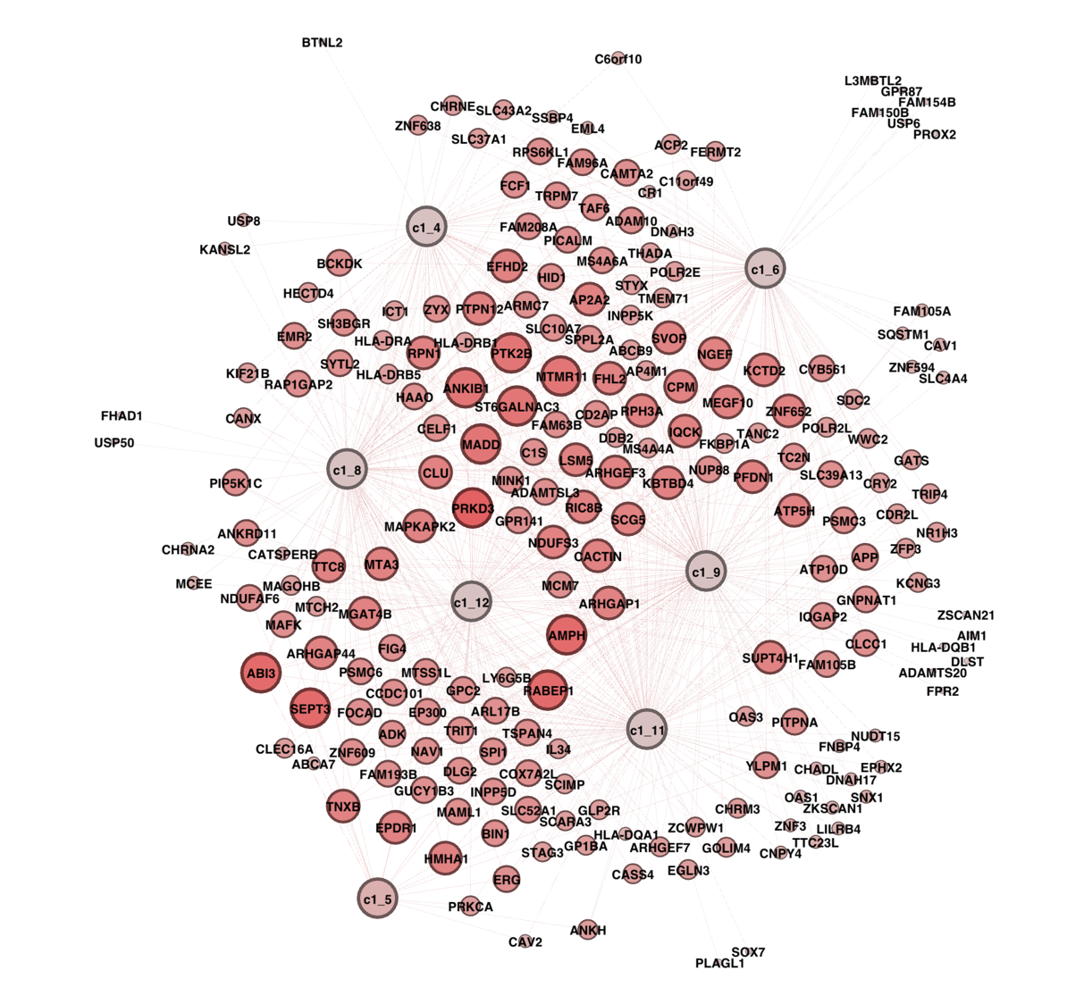
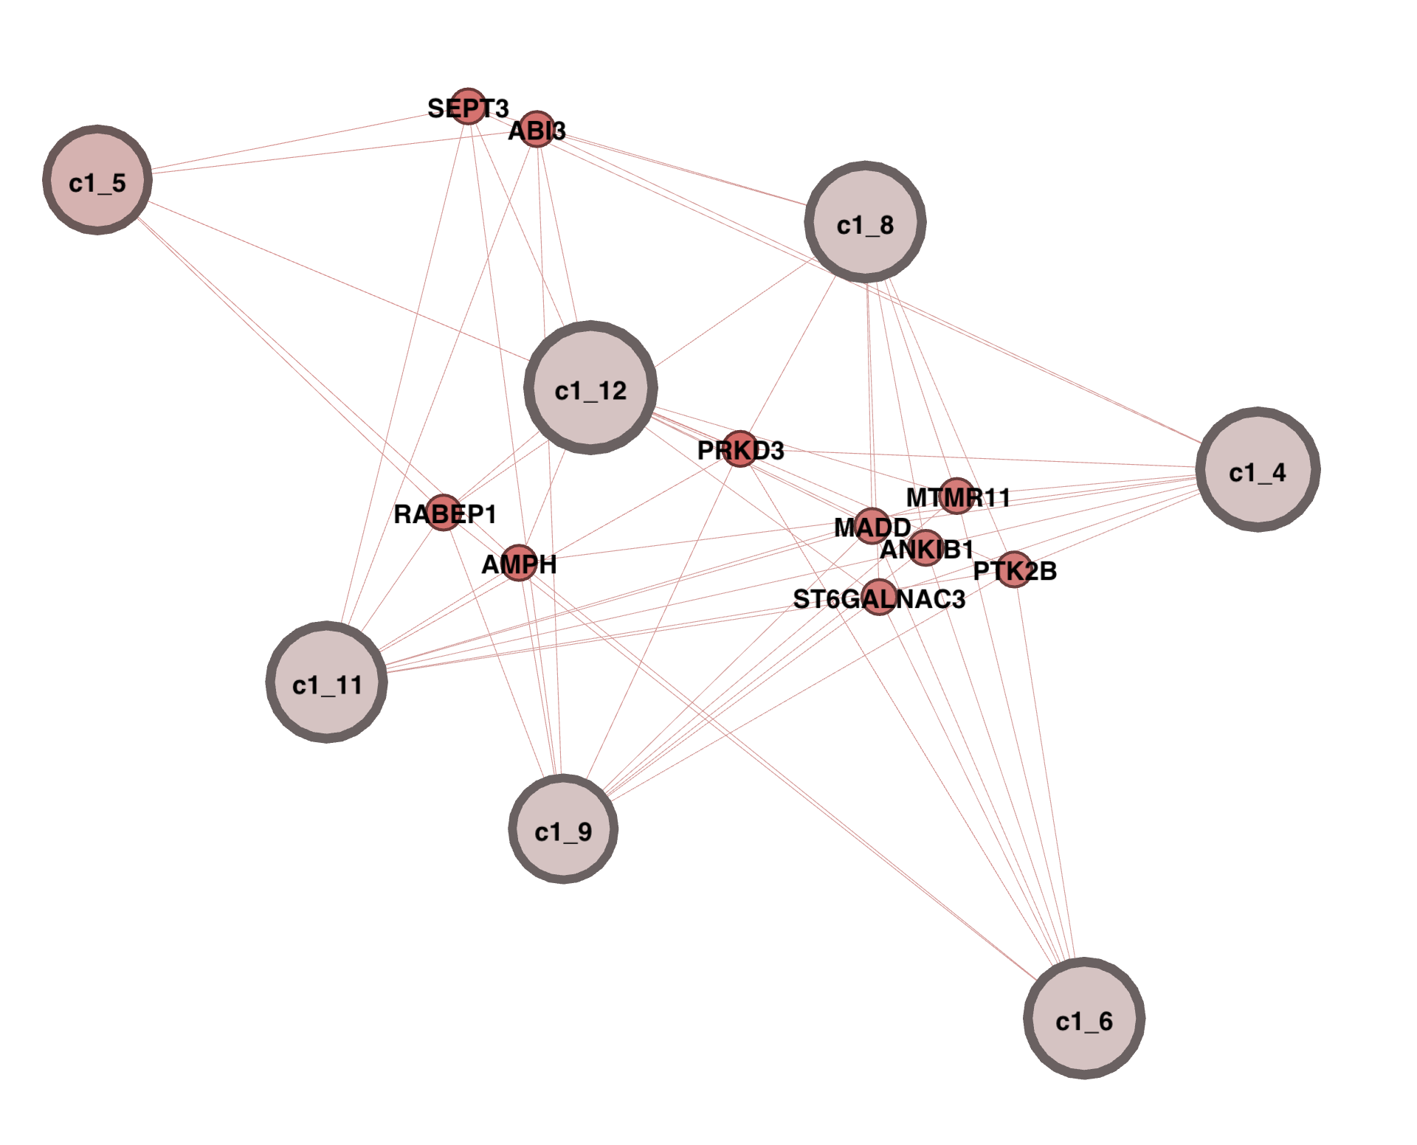
MEGENA<->IGAP Cluster Signature overlap (BM36) (DEGs within cluster + hit in IGAP + SHARED MEGENA SIGNATURE)
All DEGs
Degree >= 6

Slide 11
ROSMAP Differential MEGENA Hub analysis
Cluster 11’s MEGENA hub contribution = 390 new hubs, 31 that were DEGs
Gene Name | Cluster expression | Others expression | P-value of exp. change | Fold Change Across All Clusters
C1QB | 6.209 | 4.970 | 5.55E-07 | 504.2
C1QA | 5.963 | 4.789 | 1.94E-07 | 262.9
ICA1 | 3.163 | 4.240 | 4.61E-08 | 33.8
RBM3 | 3.489 | 4.412 | 8.74E-09 | 79.3
INHA | 1.045 | 1.909 | 2.43E-08 | 33.0
SPR | 4.105 | 3.257 | 3.24E-08 | 14.6
DYNC2LI1 | 2.796 | 3.639 | 4.01E-07 | 15.1
CDK18 | 6.179 | 5.482 | 2.88E-09 | 11.2
GSS | 3.164 | 3.841 | 1.29E-07 | 11.2
DNAJA1 | 6.303 | 5.630 | 1.30E-06 | 43.6
TRAPPC6A | 3.425 | 4.087 | 1.43E-11 | 11.5
MED29 | 3.970 | 4.617 | 2.29E-08 | 6.9
HSPH1 | 6.633 | 6.011 | 1.04E-06 | 23.4
BDH1 | 3.931 | 4.525 | 3.92E-07 | 8.7
SUN2 | 6.277 | 5.730 | 1.42E-07 | 8.1
C19orf60 | 5.622 | 6.161 | 2.08E-08 | 8.0
AHSA1 | 7.004 | 6.475 | 6.11E-09 | 10.3
MCCC2 | 2.555 | 3.083 | 1.52E-06 | 5.8
GLT25D1 | 3.776 | 3.263 | 6.83E-08 | 5.5
PYCR2 | 4.615 | 5.084 | 1.14E-06 | 5.8
COMMD4 | 4.696 | 5.121 | 7.99E-11 | 6.3
MRPS16 | 3.582 | 4.002 | 3.19E-09 | 4.9
PTGES3 | 6.521 | 6.119 | 1.51E-06 | 13.2
GSTA4 | 4.500 | 4.895 | 1.60E-06 | 7.5
TBL3 | 3.572 | 3.955 | 8.28E-07 | 5.8
AUP1 | 6.254 | 5.885 | 2.67E-07 | 4.8
LUC7L | 5.990 | 6.340 | 3.75E-09 | 5.4
ARFGAP2 | 5.052 | 5.397 | 1.03E-06 | 3.3
ZKSCAN1 | 3.587 | 3.916 | 6.55E-07 | 3.4
FIBP | 5.389 | 5.713 | 6.38E-07 | 7.4

Slide 12
ROSMAP Differential MEGENA Hub analysis
Cluster 15’s MEGENA hub contribution = 112 new hubs, 76 that were DEGs
Gene Name | Cluster expression | Others expression | P-value of exp. change | Fold Change Across All Clusters
SVOP | 2.90 | 4.02 | 8.60E-27 | 147.20
C12orf68 | 2.97 | 3.89 | 3.89E-28 | 42.52
ICAM5 | 3.26 | 4.11 | 3.21E-23 | 31.36
EGR1 | 2.16 | 3.00 | 3.07E-25 | 93.98
CDK5R2 | 4.23 | 5.04 | 2.76E-19 | 20.13
CGREF1 | 3.48 | 4.18 | 1.62E-23 | 15.93
ELMOD1 | 3.41 | 4.10 | 9.20E-22 | 24.06
SLC8A2 | 3.58 | 4.26 | 8.02E-19 | 15.68
FAM59B | 3.90 | 3.24 | 8.69E-18 | 13.58
KCNJ10 | 5.26 | 4.60 | 1.85E-13 | 15.44
LINGO1 | 5.10 | 5.76 | 4.07E-25 | 15.04
GDAP1 | 3.51 | 4.18 | 8.25E-25 | 17.02
DLG3 | 2.85 | 3.46 | 1.36E-27 | 13.21
IL3RA | 1.46 | 0.88 | 4.13E-07 | 37.39
ATP6V0D1 | 5.54 | 6.11 | 2.31E-25 | 11.43
GPI | 7.09 | 7.65 | 1.48E-22 | 9.20
MAP2K4 | 3.60 | 4.14 | 7.35E-19 | 13.22
LRP4 | 5.53 | 5.00 | 3.68E-19 | 16.34
EGR4 | 0.89 | 1.42 | 1.25E-23 | 16.24
KLF15 | 4.23 | 3.71 | 2.44E-17 | 25.15
NRSN2 | 5.73 | 6.25 | 3.00E-22 | 6.63
APP | 7.48 | 7.99 | 1.43E-20 | 12.41
UGT8 | 3.59 | 3.08 | 1.83E-09 | 14.33
DYNC2LI1 | 3.16 | 3.67 | 4.99E-14 | 15.13
AASDHPPT | 3.89 | 4.39 | 1.38E-18 | 10.41
PITHD1 | 5.79 | 6.29 | 6.75E-24 | 8.94
SRGN | 4.34 | 3.84 | 8.24E-07 | 177.35
ALDOA | 9.58 | 10.07 | 1.54E-24 | 7.46
PRKX | 2.51 | 2.02 | 3.66E-17 | 15.21
CAPRIN2 | 3.51 | 3.99 | 8.83E-17 | 6.87

Slide 13
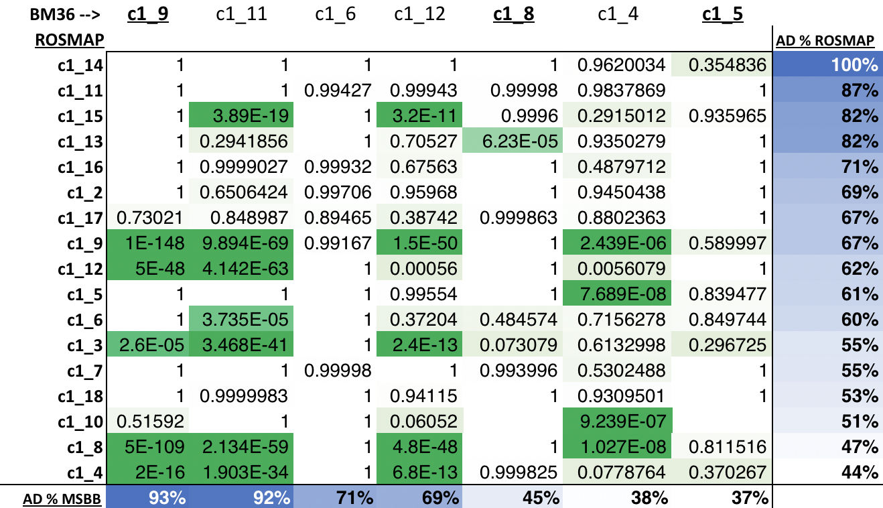
ROSMAP vs MSBB – SuperExactTest
AD “2”
AD “1”

Slide 14
AD Cluster Signatures

Slide 15
ROSMAP clusters <-> AD biomarkers
Genes from: http://www.alzforum.org/alzbiomarker
Normalized gene expression
Clusters from phenotypic analysis (hierarchical)
1: 6,7,8,3,4
2: 10,15,12,9,17,2
3: 18,11,14
4: 13,16,5
Genes perturbed:
1: (up) MAPT, APP, PSEN2, PSEN1, ALB, others...
2: (up) TYROBP, TREM2, etc. with APOE
3: (up) TYROBP, TREM2, CHI3L1, BACE2, CCL2 without APOE
4: (up) NRGN, AGER, MAPT, (down) ITM2B, (down) PSEN1

Slide 16
ROSMAP clusters <-> AD biomarkers
Genes from: http://www.alzforum.org/alzbiomarker
Normalized gene expression
Linear Gene-Gene Correlation

Slide 17
Heatmap of gene expression across each cluster for top 15 most informative genes (highest intercluster fold change) per cluster
Clusters from phenotypic analysis:
1: 6,7,8,3,4 = AD 1b
2: 10,15,12,9,17,2 = AD 1a
3: 18,11,14 = AD 1b/2
4: 13,16,5 = AD 2
Grouped clusters from hierarchical clustering:
1: 8,4,3,6
2: 13,16,5
3: 2,11,14
4: 12,15,10,7,9,17,18
Genes with high fold change:
1:GSTM1, RPL9, VGF, NEUROD6, NCALD, SVOP, PCSK1...
2: STC1, LY6H,AMIGO3, SPHAR, PCDHA1...
3: HLA-DRB5, HLA-DRB1,HERC2P3,GIPR,S100A4...
4: C1Q complex, CHI3L1,SERPINA1,SOCS3,IL6, FOS, ZFP36,
Notes:
1: 8,4,3,6
2: 13,16,5
3: 2,11,14
4: 12,15,10,7,9,17,18

Slide 18
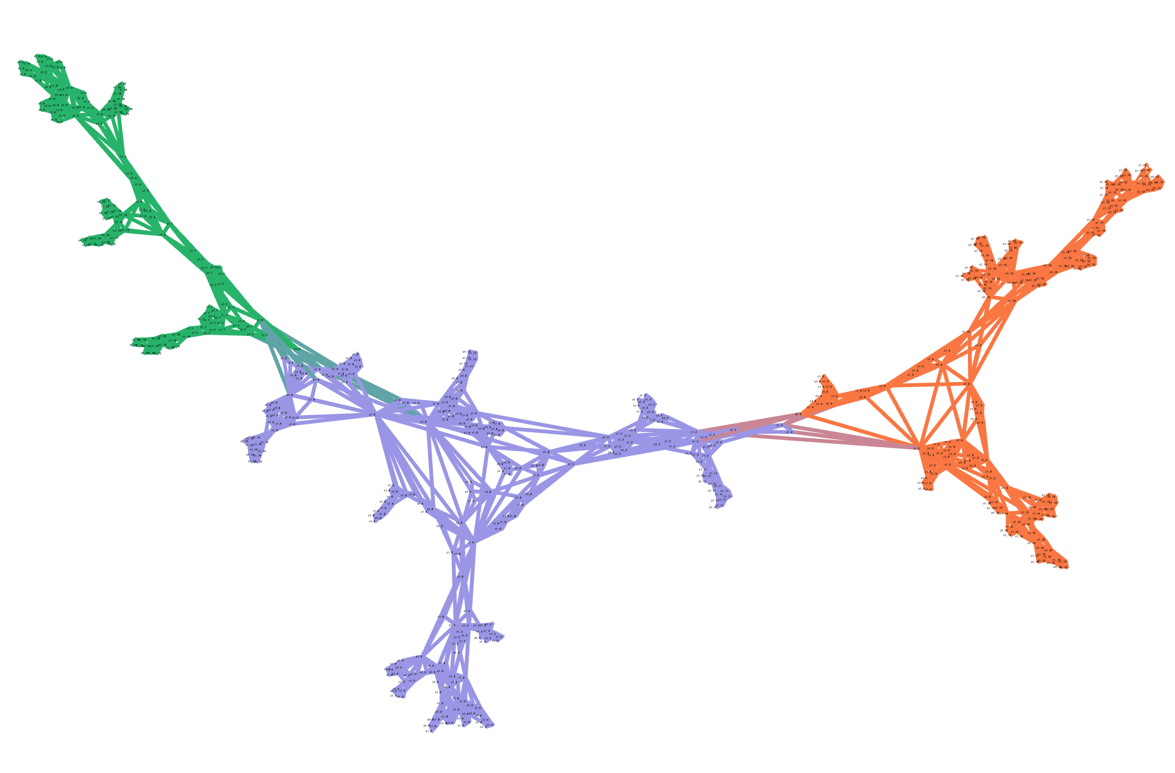
ROSMAP DGCA Analysis Genes that had differential connectivity between clusters
Clusters from phenotypic analysis:
1: 6,7,8,3,4 = AD 1b
2: 10,15,12,9,17,2 = AD 1a
3: 18,11,14 = AD 1b/2
4: 13,16,5 = AD 2
Genes perturbed:
1: (up) MAPT, APP, PSEN2, PSEN1, ALB, others...
2: (up) TYROBP, TREM2, etc. with APOE
3: (up) TYROBP, TREM2, CHI3L1, BACE2, CCL2 without APOE
4: (up) NRGN, AGER, MAPT, (down) ITM2B, (down) PSEN1
15
AD 1a:
15, 12, 10, 9
13
&
10
AD 2:
13,5,16,18,7
6
8
AD 1b:
8,4,3,6,2,11,17,14

Slide 19
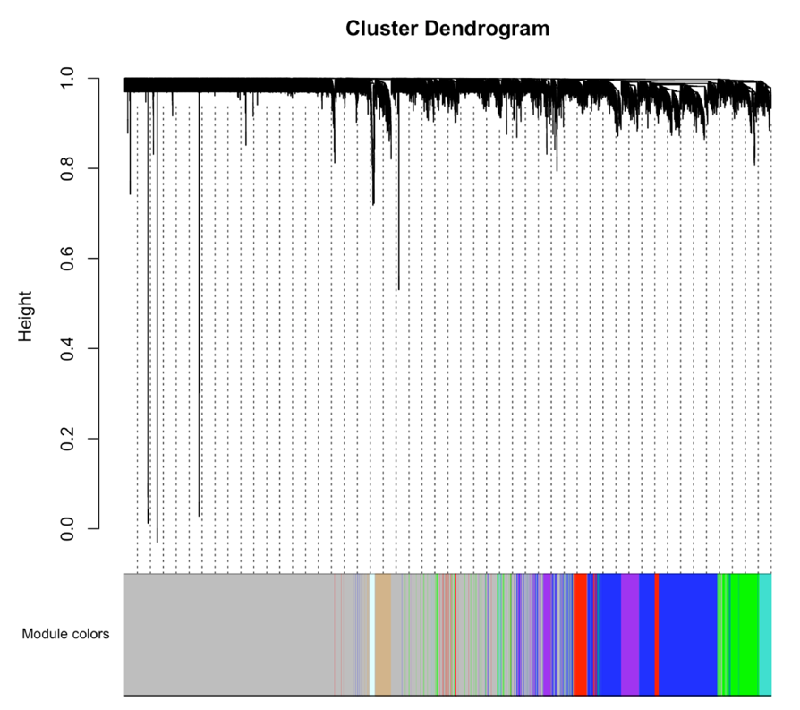
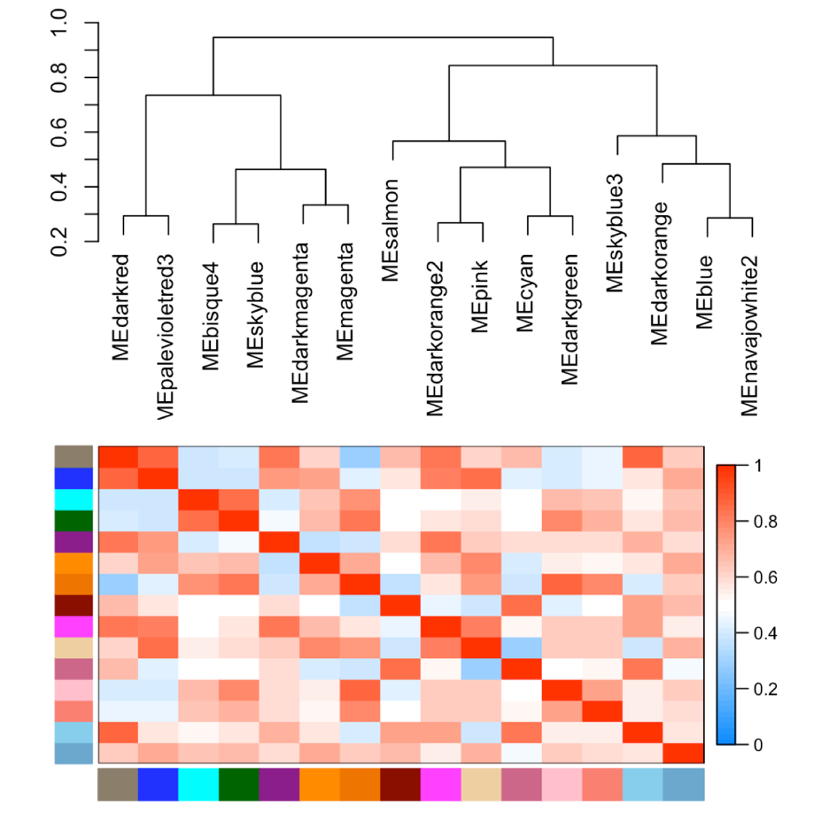
WGCNA: gene modules from median cluster gene expression

Slide 20
WGCNA: gene modules from median cluster gene expression
Module-trait relationships
Clusters from phenotypic analysis:
1: 6,7,8,3,4 = AD 1b
2: 10,15,12,9,17,2 = AD 1a
3: 18,11,14 = AD 1b/2
4: 13,16,5 = AD 2
Clusters from WGCNA analysis:
1: 12,7,10,9
2: 11,18,14,17,2
3: 8,4,3,6
4: 13,16,5
Singleton: 15
Genes perturbed:
1: (up) MAPT, APP, PSEN2, PSEN1, ALB, others...
2: (up) TYROBP, TREM2, etc. with APOE
3: (up) TYROBP, TREM2, CHI3L1, BACE2, CCL2 without APOE
4: (up) NRGN, AGER, MAPT, (down) ITM2B, (down) PSEN1

Slide 21
Statistics and KDA

Slide 22
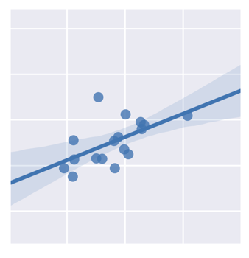
WGCNA: Weighted Gene Correlation Network Analysis
First, determine all pairwise correlations from the input RNA-seq data and create a correlation network
Edge exists in network?
= 1 if weight > threshold
= 0 otherwise
For all edges, calculate edge weight as: |R|^{B}
B and threshold chosen dynamically so the network is scale-free, that is:
m Samples
R = 0.8
X₁
X₂
X₃
...
...
...
X_{n}
Y₁
Y₂
Y₃
...
...
...
Y_{n}
n Genes
Gene1
. . .
Correlation
Network
Gene2
Pairwise correlations between rows indicate gene-gene connectiveness
% of nodes
Gene expression data
Degree

Slide 23
WGCNA: Weighted Gene Correlation Network Analysis
Module detection using the topological overlap matrix (TOM) and hierarchical clustering
# of neighbors reachable by both nodes excluding self
TOM =
8
9
min(#neighbors x, #neighbors y)
6
7
Nodes → TOM score | 1 + 2 | 1+3 | 2+3
0 hops (connected?) | 1.0 | 0.0 | 1.0
1 hop | 3/5 | 1/2 | 1.0
2 hops | 1.0 | 7/9 | 1.0
5
11
4
10
1
2
3
Zhang B, Horvath S. A General Framework for Weighted Gene Co-expression Network Analysis, Statistical Applications in Genetics and Molecular Biology (2005)

Slide 24
WGCNA: Weighted Gene Correlation Network Analysis
Module detection using the topological overlap matrix (TOM) and hierarchical clustering
# of neighbors reachable by both nodes excluding self
TOM =
8
9
min(#neighbors x, #neighbors y)
6
7
Nodes → TOM score | 1 + 2 | 1+3 | 2+3
0 hops (connected?) | 1.0 | 0.0 | 1.0
1 hop | 3/5 | 1/2 | 1.0
2 hops | 1.0 | 7/9 | 1.0
5
11
4
10
1
2
3
Zhang B, Horvath S. A General Framework for Weighted Gene Co-expression Network Analysis, Statistical Applications in Genetics and Molecular Biology (2005)

Slide 25
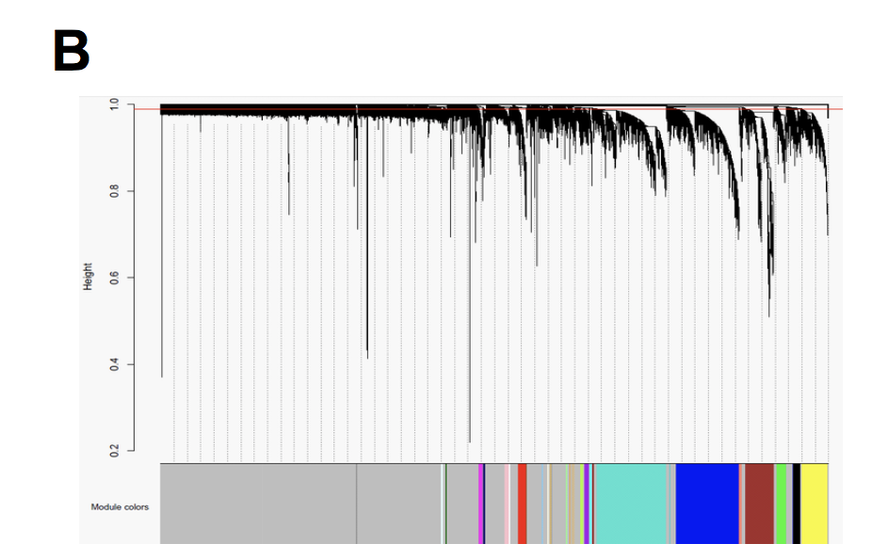
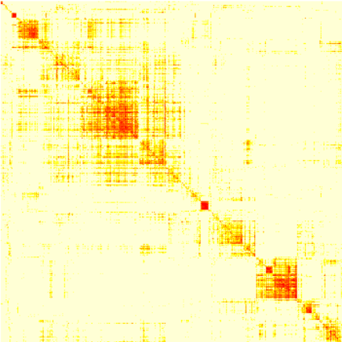
WGCNA: Weighted Gene Correlation Network Analysis
Identify genes most tightly correlated or anti-correlated with key driver gene of interest
n Genes
T_{1,1}
T_{2,1}
T_{3,1}
...
...
...
T_{n,1}
T_{1,2}
T_{2,2}
T_{3,2}
...
...
...
T_{n,2}
n Genes
. . .
Heatmap of Network Similarity
Hierarchical Clustering
Modules = colors
TOM Similarities
Heatmap from: Zhang B, Horvath S. A General Framework for Weighted Gene Co-expression Network Analysis, Statistical Applications in Genetics and Molecular Biology (2005)

Slide 26
3D WGCNA
Idea: extend TOM similarity for the 3D case where a gene in one network (e.g. APP) is connected to itself in another network, with an edge weight based on their local graphlet similarity or based on some other metric
Input Networks
Unified Graph

Slide 27
3D WGCNA
Idea: extend TOM similarity for the 3D case where a gene in one network (e.g. APP) is connected to itself in another network, with an edge weight based on their local graphlet similarity or based on some other metric
Input Networks
Unified Graph

